Slide 1
Kubernetes in Action
Part III
2026.08.25

Slide 2
Services
Enabling Clients to Discover and Talk to Pods

Slide 3
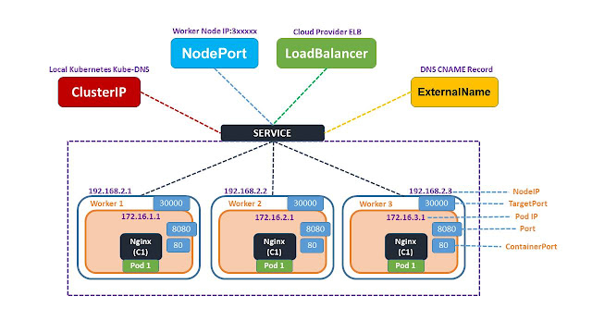
What is Services?
Services :
  You’ve learned about pods and how to deploy them through ReplicaSets and similar resources to ensure they keep running. Although certain pods can do their work independently of an external stimulus, many applications these days are meant to respond to external requests. For example, in the case of microservices, pods will usually respond to HTTP requests coming either from other pods inside the cluster or from clients outside the cluster.
  Pods need a way of finding(discovering) other pods if they want to consume the services they provide. Unlike in the non-Kubernetes world, where a sysadmin would configure each client app by specifying the exact IP address or hostname of the server providing the service in the client’s configuration files, doing the same in Kubernetes wouldn’t work, because
    Pods are ephemeral—They may come and go at any time, whether it’s because a pod is removed from a node to make room for other pods, because someone scaled down the number of pods, or because a cluster node has failed.
    Kubernetes assigns an IP address to a pod after the pod has been scheduled to a node and before it’s started—Clients thus can’t know the IP address of the server pod up front.
    Horizontal scaling means multiple pods may provide the same service—Each of those pods has its own IP address. Clients shouldn’t care how many pods are backing the service and what their IPs are. They shouldn’t have to keep a list of all the individual IPs of pods. Instead, all those pods should be accessible through a single IP address.
  To solve these problems, Kubernetes also provides another resource type, ”Services”.

Slide 4
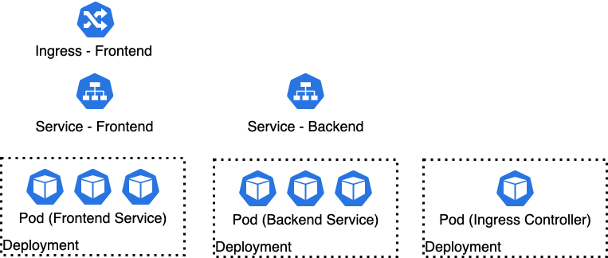
Introducing Services(1/22)
Kubernetes Service :
  A Kubernetes Service is a resource you create to make a single, constant point of entry to a group of pods providing the same service. Each service has an IP address and port that never change while the service exists. Clients can open connections to that IP and port, and those connections are then routed to one of the pods backing that service. This way, clients of a service don’t need to know the location of individual pods providing the service, allowing those pods to be moved around the cluster at any time.
  For example, you have a frontend web server and a backend database server. There may be multiple pods that all act as the frontend, but there may only be a single backend database pod. You need to solve two problems to make the system function:
    External clients need to connect to the frontend pods without caring if there’s only a single web server or hundreds.
    The frontend pods need to connect to the backend database. Because the database runs inside a pod, it may be moved around the cluster over time, causing its IP address to change. You don’t want to reconfigure the frontend pods every time the backend database is moved.

Slide 5
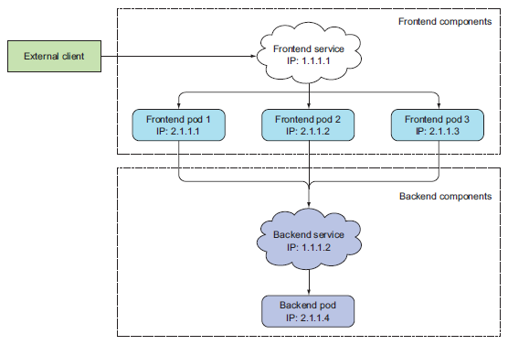
Introducing Services(2/22)
Kubernetes Service :
  By creating a service for the frontend pods and configuring it to be accessible from outside the cluster, you expose a single, constant IP address through which external clients can connect to the pods. Similarly, by also creating a service for the backend pod, you create a stable address for the backend pod.
  The service address doesn’t change even if the pod’s IP address changes. Additionally, by creating the service, you also enable the frontend pods to easily find the backend service by its name through either environment variables or DNS(Domain Name Service). All the components of your system (the two services, the two sets of pods backing those services, and the interdependencies between them) are shown in the following figure.

Slide 6
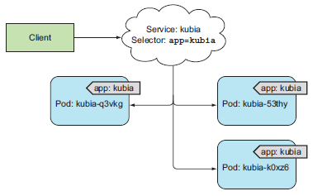
Introducing Services(3/22)
Creating Services :
  A service can be backed by more than one pod. Connections to the service are load-balanced across all the backing pods. But how exactly do you define which pods are part of the service and which aren’t?
  You probably remember “label selectors” and how they’re used in ReplicationControllers and other pod controllers to specify which pods belong to the same set. The same mechanism is used by services in the same way, as you can see in following figure.
  In the Part II, you created a ReplicationController which then ran three instances of the pod containing the Node.js app. Create the ReplicationController again and verify three pod instances are up and running. After that, you’ll create a Service for those three pods.

Slide 7
Introducing Services(4/22)
Creating a Service Through kubectl Command :
  The easiest way to create a service is through “kubectl expose” command. The “expose” command created a Service resource with the same pod selector as the one used by the ReplicationController, thereby exposing all its pods through a single IP address and port.
  Instead of using the expose command, you’ll create a service manually by posting a YAML to the Kubernetes API server. Create a file called “kubia-svc.yaml” with the following listing’s contents.
  You’re defining a service called “kubia”, which will accept connections on “port 80” and route each connection to “port 8080” of one of the pods matching the “app=kubia” label selector.
apiVersion: v1
kind: Service
metadata:
name: kubia
spec:
ports:
- port: 80
targetPort: 8080
selector:
app: kubia
kubia-svc.yaml

Slide 8
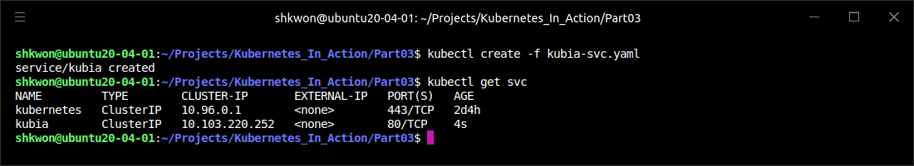
Introducing Services(5/22)
Creating a Service Through kubectl Command :
  Create the service by posting the file using “kubectl create” command. After posting the YAML, you can list all Service resources in your namespace and see that an internal cluster IP has been assigned to your service :
  The list shows that the IP address. Because this is the cluster IP, it’s only accessible from inside the cluster. The primary purpose of services is exposing groups of pods to other pods in the cluster, but you’ll usually also want to expose services externally.
$ kubectl create -f kubia-svc.yaml
$ kubectl get svc

Slide 9
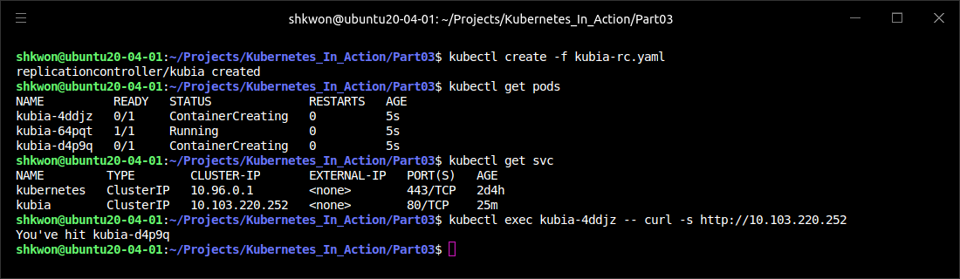
Introducing Services(6/22)
Examining Your New Service :
  You can send requests to your service from within the cluster in a few ways :
    The obvious way is to create a pod that will send the request to the service’s cluster IP and log the response. You can then examine the pod’s log to see what the service’s response was.
    You can “ssh” into one of the Kubernetes nodes and use the “curl” command.
    You can execute the “curl” command inside one of your existing pods through the “kubectl exec” command.
  The “kubectl exec” command allows you to remotely run arbitrary commands inside an existing container of a pod. This comes in handy when you want to examine the contents, state, and/or environment of a container. List the pods with the “kubectl get pods” command and choose one as your target for the “exec” command. You’ll also need to obtain the cluster IP of your service (using “kubectl get svc”, for example). When running the following commands yourself, be sure to replace the pod name and the service IP with your own :
$ kubectl exec kubia-xxxxx -- curl -s http://clust_IP_address

Slide 10
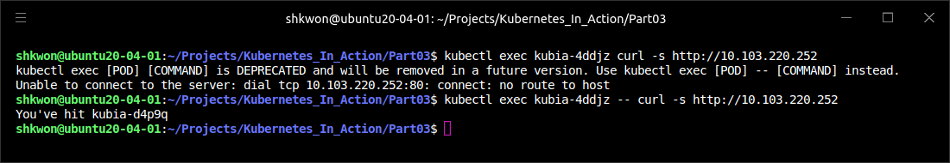
NOTE : The Double Dash(“--”) in Command
Signaling the End of Command Options for kubectl :
  The double dash (“--”) in the command signals the end of command options for kubectl. Everything after the double dash is the command that should be executed inside the pod. Using the double dash isn’t necessary if the command has no arguments that start with a dash(“-”). But in your case, if you don’t use the double dash there, the “-s” option in “curl” would be interpreted as an option for “kubectl exec” and would result in the following strange and highly misleading error :
  NOTE : This has nothing to do with your service.
$ kubectl exec kubia-xxxxx curl -s http://cluster_IP_address

Slide 11
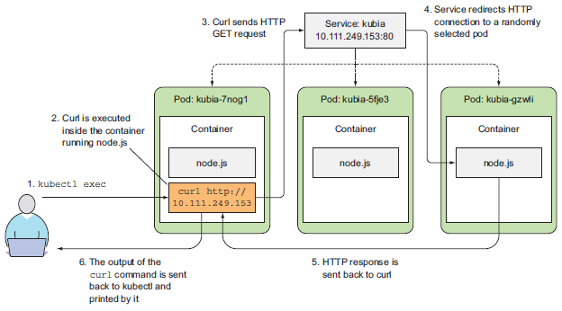
Introducing Services(7/22)
Remotely Executing Commands in Running Containers :
  The following figure shows the sequence of events. You instructed Kubernetes to execute the “curl” command inside the container of one of your pods. “Curl” sent an HTTP request to the service IP, which is backed by three pods. The Kubernetes service proxy intercepted the connection, selected a random pod among the three pods, and forwarded the request to it. “Node.js” running inside that pod then handled the request and returned an HTTP response containing the pod’s name. “Curl” then printed the response to the standard output, which was intercepted and printed to its standard output on your local machine by kubectl.
  In the previous example, you executed the curl command as a separate process, but inside the pod’s main container. This isn’t much different from the actual main process in the container talking to the service.

Slide 12
Introducing Services(8/22)
Configuring Session Affinity on the Service :
  If you execute the same command a few more times, you should hit a different pod with every invocation, because the service proxy normally forwards each connection to a randomly selected backing pod, even if the connections are coming from the same client.
  If, on the other hand, you want all requests made by a certain client to be redirected to the same pod every time, you can set the service’s “sessionAffinity” property to “ClientIP” (instead of None, which is the default), as shown in the following listing.
  This makes the service proxy redirect all requests originating from the same client IP to the same pod. As an exercise, you can create an additional service with session affinity set to ClientIP and try sending requests to it.
  Kubernetes supports only two types of service session affinity: None and ClientIP. You may be surprised it doesn’t have a cookie-based session affinity option, but you need to understand that Kubernetes services don’t operate at the HTTP level. Services deal with TCP and UDP packets and don’t care about the payload they carry. Because cookies are a construct of the HTTP protocol, services don’t know about them, which explains why session affinity cannot be based on cookies.
apiVersion: v1
kind: Service
spec:
sessionAffinity: ClientIP
...

Slide 13
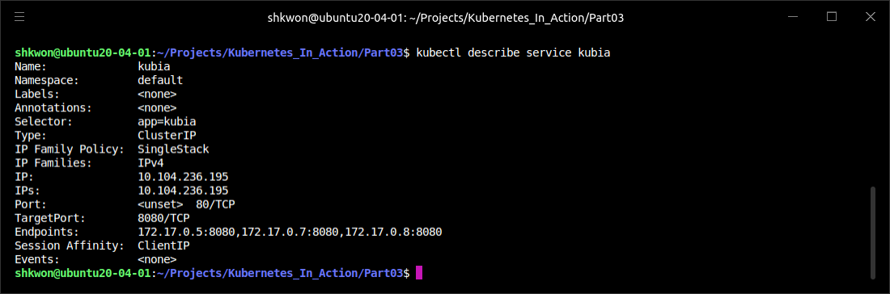
NOTE : Session Affinity
The Create Service :
  From the previous example, you can delete and create a new service using “$ kubectl delete service kubia” and “$kubectl create –f “kubia-svc.yaml”. In this case, the “kubia-svc.yaml” has “sessionAffinity: ClientIP” property.
  You can check the setting with “$ kubectl describe service kubia” command.

Slide 14
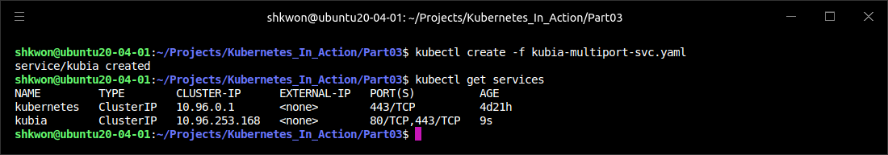
Introducing Services(9/22)
Exposing Multiple Ports in the Same Service :
  Your service exposes only a single port, but services can also support multiple ports. For example, you can use a single service to forward both port 80 and 443 to the pod’s ports 8080 and 8443. You don’t need to create two different services in such cases. Using a single, multi-port service exposes all the service’s ports through a single cluster IP. When creating a service with multiple ports, you must specify a name for each port. The label selector applies to the service as a whole—it can’t be configured for each port individually. If you want different ports to map to different subsets of pods, you need to create two services
apiVersion: v1
kind: Service
metadata:
name: kubia
spec:
ports:
- name: http
port: 80
targetPort: 8080
- name: https
port: 443
targetPort: 8443
selector:
app: kubia
kubia-multiport-svc.yaml

Slide 15
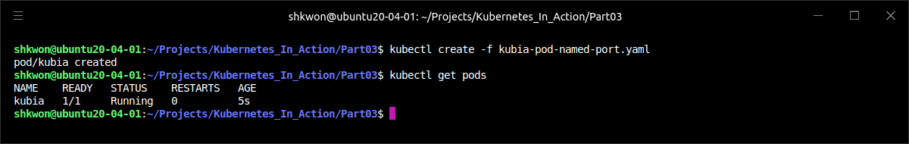
Introducing Services(10/22)
Using Named Ports :
  In all previous examples, you’ve referred to the target port by its number, but you can also give a name to each pod’s port and refer to it by name in the service spec. This makes the service spec slightly clearer, especially if the port numbers aren’t well-known.
kubia-pod-named-port.yaml
apiVersion: v1
kind: Pod
metadata:
name: kubia
spec:
containers:
- name: kubia
image: knix008/kubia
ports:
- name: http
containerPort: 8080
- name: https
containerPort: 8443

Slide 16
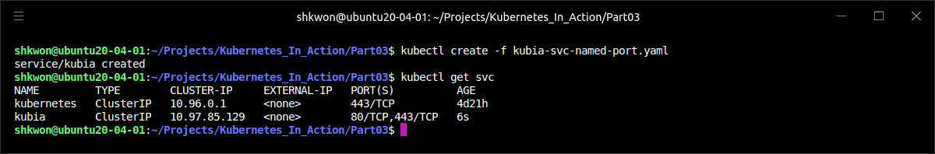
Introducing Services(11/22)
Using Named Ports :
  You can then refer to the ports by name in the service spec.
  The biggest benefit of doing so is that it enables you to change port numbers later without having to change the service spec. As you spin up pods with the new ports, client connections will be forwarded to the appropriate port numbers, depending on the pod receiving the connection (port 8080 on old pods and port 80 on the new ones).
apiVersion: v1
kind: Service
metadata:
name: kubia
spec:
ports:
- name: http
port: 80
targetPort: http
- name: https
port: 443
targetPort: https
kubia-svc-named-port.yaml

Slide 17
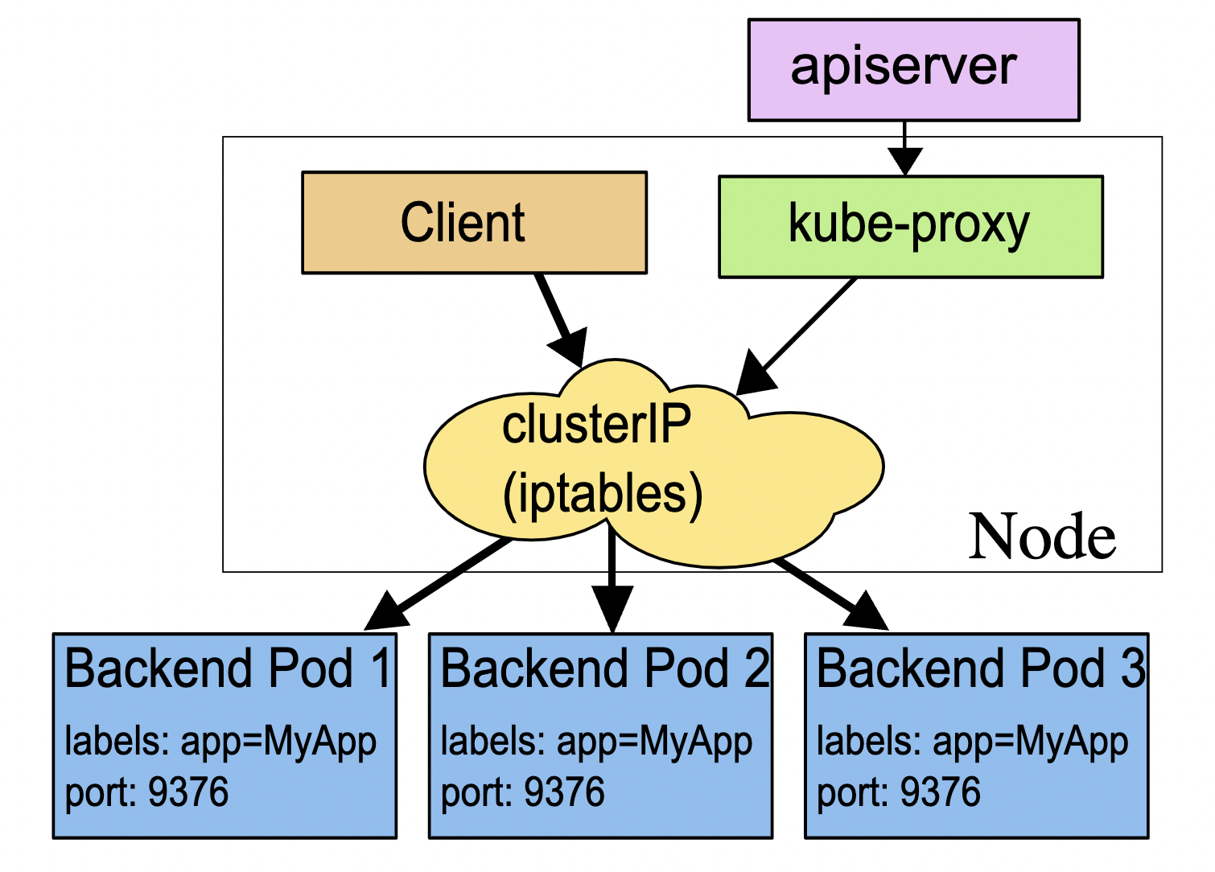
Introducing Services(12/22)
Discovering Services :
  By creating a service, you now have a single and stable IP address and port that you can hit to access your pods. This address will remain unchanged throughout the whole lifetime of the service. Pods behind this service may come and go, their IPs may change, their number can go up or down, but they’ll always be accessible through the service’s single and constant IP address.
  But how do the client pods know the IP and port of a service? Do you need to create the service first, then manually look up its IP address and pass the IP to the configuration options of the client pod? Not really. Kubernetes also provides ways for client pods to discover a service’s IP and port.

Slide 18
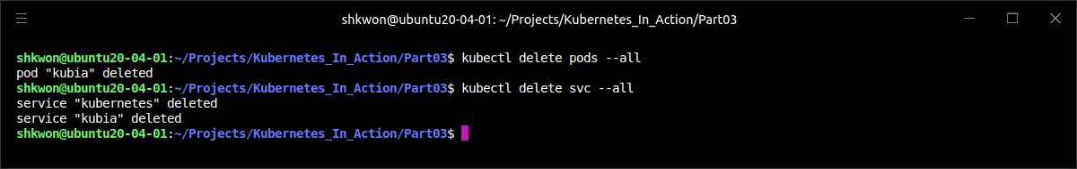
Introducing Services(13/22)
Discovering Services through Environment Variables :
  When a pod is started, Kubernetes initializes a set of environment variables pointing to each service that exists at that moment. If you create the service before creating the client pods, processes in those pods can get the IP address and port of the service by inspecting their environment variables.
  Before you can see environment variables for your service, you first need to delete all the pods and let the ReplicationController create new ones. You may remember you can delete all pods without specifying their names like this :
$ kubectl delete pods --all

Slide 19
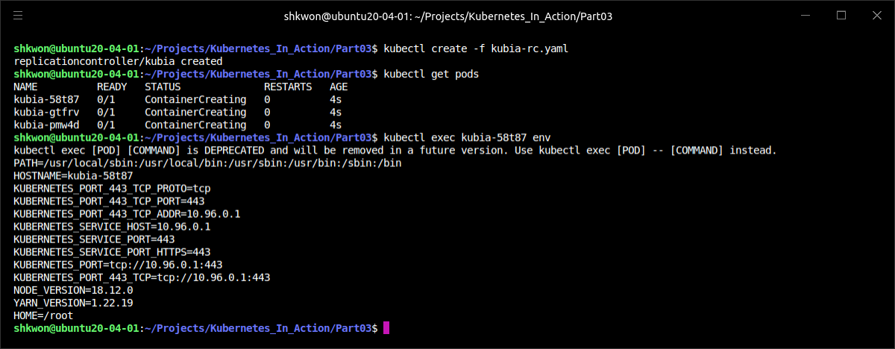
Introducing Services(14/22)
Discovering Services through Environment Variables :
  Now you can list the new pods and pick one as your target for the “kubectl exec” command. Once you’ve selected your target pod, you can list environment variables by running the “env” command inside the container, as shown in the following listing.

Slide 20
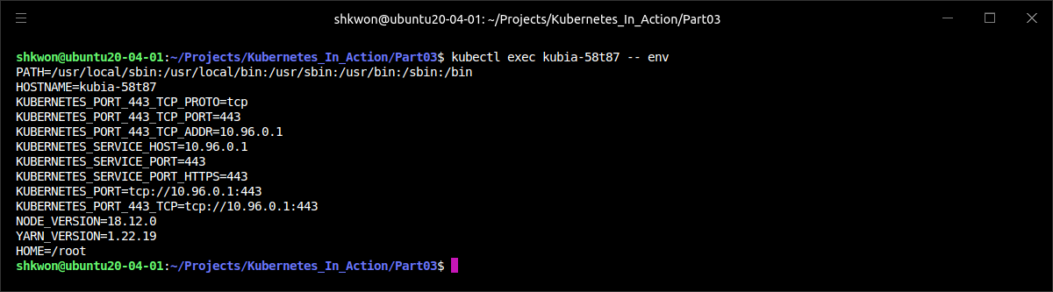
NOTE : Executing Command in a Pod
Using kubectl exec command :
  You need to specify “-- env” to execute “env” command in a pod. The “--” is required in this case.

Slide 21
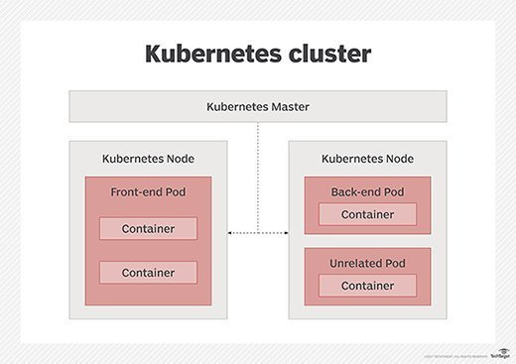
Introducing Services(15/22)
Discovering Services through Environment Variables :
  Two services are defined in your cluster: the kubernetes and the kubia service (you saw this earlier with the “kubectl get svc” command); consequently, two sets of service-related environment variables are in the list. Among the variables that pertain to the “kubia” service you created at the beginning, you’ll see the “KUBIA_SERVICE_HOST” and the “KUBIA_SERVICE_PORT” environment variables, which hold the IP address and port of the “kubia” service, respectively.
  Turning back to the frontend-backend example we saw before, when you have a frontend pod that requires the use of a backend database server pod, you can expose the backend pod through a service called “backend-database” and then have the frontend pod look up its IP address and port through the environment variables “BACKEND_DATABASE_SERVICE_HOST” and “BACKEND_DATABASE_SERVICE_PORT”.
  NOTE : Dashes in the service name are converted to underscores and all letters are uppercased when the service name is used as the prefix in the environment variable’s name.

Slide 22
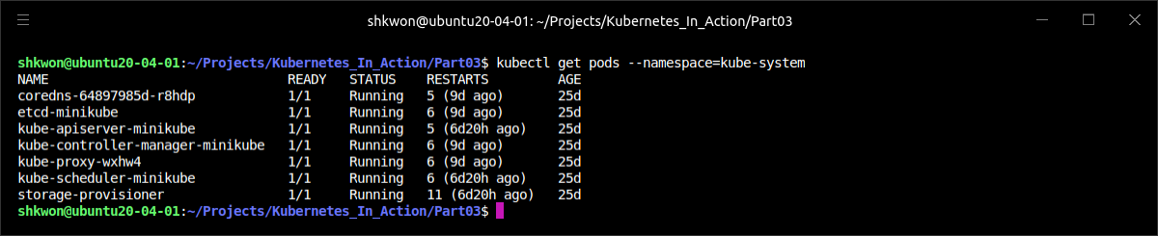
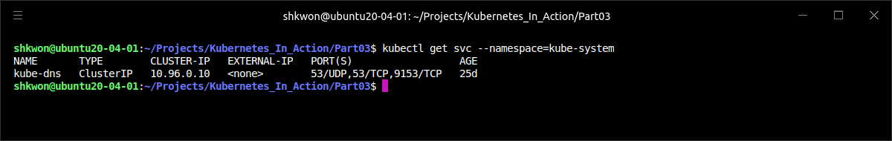
Introducing Services(16/22)
Discovering Services through DNS :
  When you listed pods in the “kube-system” namespace, there are the pods called “coredns”. The “kube-system namespace” also includes a corresponding service with the same name.
  NOTE : The CoreDNS Service is named “kube-dns” in the “metadata.name” field. The intent is to ensure greater interoperability with workloads that relied on the legacy “kube-dns” Service name to resolve addresses internal to the cluster. Using a Service named “kube-dns” abstracts away the implementation detail of which DNS provider is running behind that common name.

Slide 23
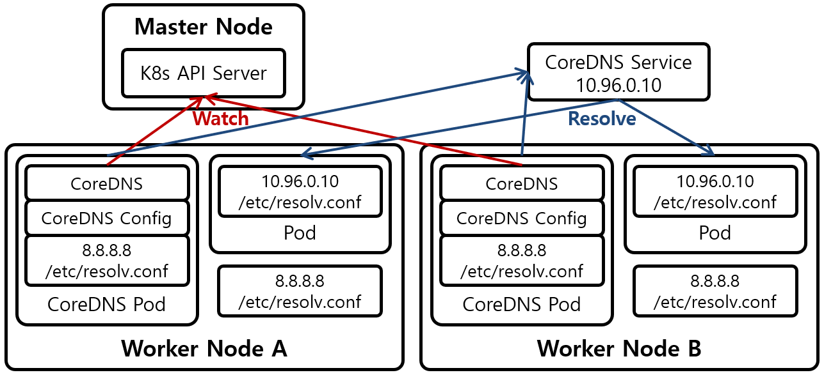
Introducing Services(17/22)
Discovering Services through DNS :
  As the name suggests, the pod runs a DNS server, which all other pods running in the cluster are automatically configured to use (Kubernetes does that by modifying each container’s “/etc/resolv.conf” file). Any DNS query performed by a process running in a pod will be handled by Kubernetes’ own DNS server, which knows all the services running in your system.
  NOTE : Whether a pod uses the internal DNS server or not is configurable through the “dnsPolicy” property in each pod’s spec. Each service gets a DNS entry in the internal DNS server, and client pods that know the name of the service can access it through its “fully qualified domain name (FQDN)” instead of resorting to environment variables.

Slide 24
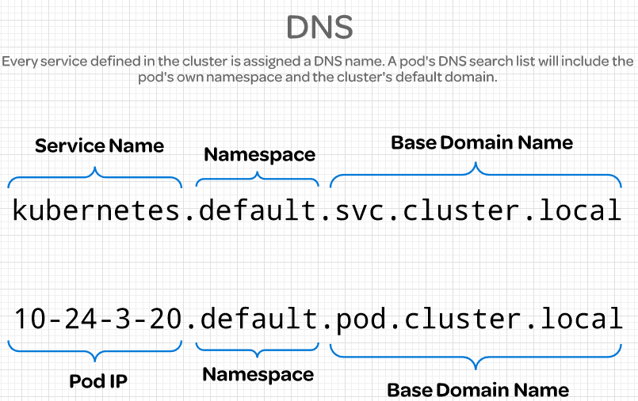
Introducing Services(18/22)
Connecting to the Service through It’s FQDN :
  To revisit the frontend-backend example, a frontend pod can connect to the backend-database service by opening a connection to the following FQDN :
  “backend-database” corresponds to the service name, default stands for the namespace the service is defined in, and “svc.cluster.local” is a configurable cluster domain suffix used in all cluster local service names.
  NOTE : The client must still know the service’s port number. If the service is using a standard port (for example, 80 for HTTP or 5432 for Postgres), that shouldn’t be a problem. If not, the client can get the port number from the environment variable.
  Connecting to a service can be even simpler than that. You can omit the “svc.cluster.local” suffix and even the namespace, when the frontend pod is in the same namespace as the database pod. You can thus refer to the service simply as “backend-database”.
backend-database.default.svc.cluster.local

Slide 25
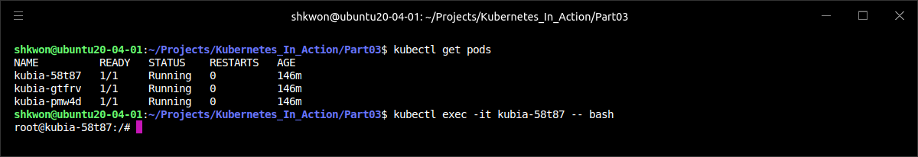
Introducing Services(19/22)
Connecting to the Service through It’s FQDN :
  You’ll try to access the kubia service through its FQDN instead of its IP. Again, you’ll need to do that inside an existing pod. You already know how to use “kubectl exec” to run a single command in a pod’s container, but this time, instead of running the “curl” command directly, you’ll run the “bash” shell instead, so you can then run multiple commands in the container(similar to “docker exec -it bash”).
  You can use the “kubectl exec” command to run “bash” (or any other shell) inside a pod’s container. This way you’re free to explore the container as long as you want, without having to perform a “kubectl exec” for every command you want to run.
  NOTE : The shell’s binary executable must be available in the container image for this to work.
  To use the shell properly, you need to pass the “-it”(interactive terminal) option to “kubectl exec” command :
$ kubectl exec -it kubia-xxxxx -- bash

Slide 26
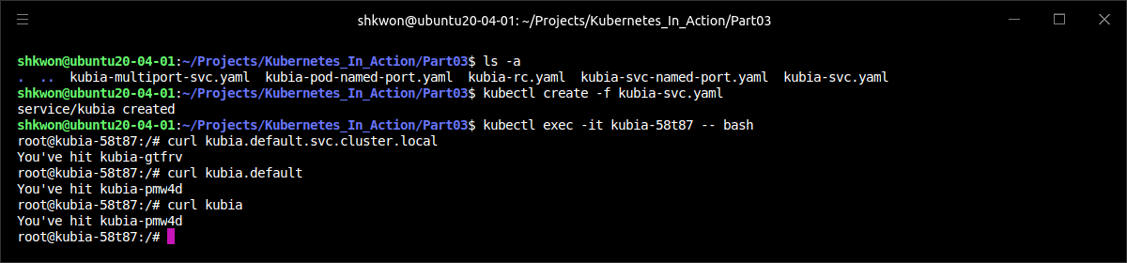
Introducing Services(20/22)
Connecting to the Service through It’s FQDN :
  You’re now inside the container. You can use the ”curl” command to access the “kubia” service in any of the following ways :
  NOTE : Before you run the previous commands, you need to make it sure that the “kubia” service is created first. You can create the “kubia” service with “$ kubectl create -f kubia-svc.yaml” command.
$ curl http://kubia.default.svc.cluster.local
$ curl http://kubia.default
$ curl http://kubia

Slide 27
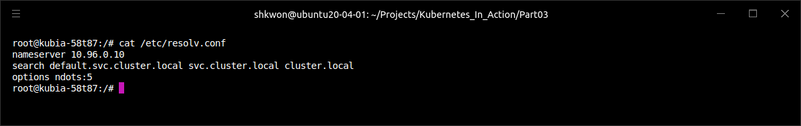
Introducing Services(21/22)
Connecting to the Service through It’s FQDN :
  You can hit your service by using the service’s name as the hostname in the requested URL. You can omit the namespace and the “svc.cluster.local” suffix because of how the DNS resolver inside each pod’s container is configured.
  Look at the “/etc/resolv.conf” file in the container and you’ll understand :

Slide 28
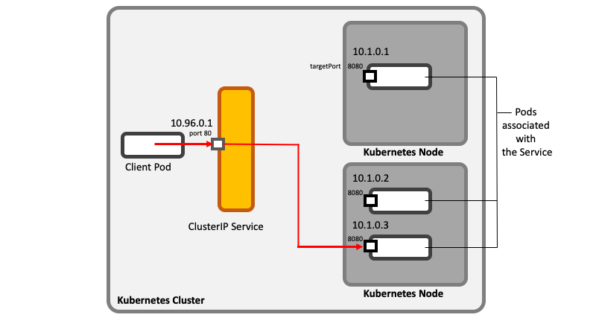
Introducing Services(22/22)
Understanding Why You Can’t Ping a Service IP :
  One last thing before we move on. You know how to create services now, so you’ll soon create your own. But what if, for whatever reason, you can’t access your service? You’ll probably try to figure out what’s wrong by entering an existing pod and trying to access the service like you did in the last example. Then, if you still can’t access the service with a simple “curl” command, maybe you’ll try to “ping” the service IP to see if it’s up. Let’s try that now :
  NOTE : In “kubia” container image don’t have “ping” command inside. If you want to test the above command, you need to build another docker image, which is including “ping” command inside.
  The “curl”-ing the service works, but “ping”-ing it doesn’t. That’s because the service’s cluster IP is a virtual IP, and only has meaning when combined with the service port. We will see it later.
$ ping kubia

Slide 29
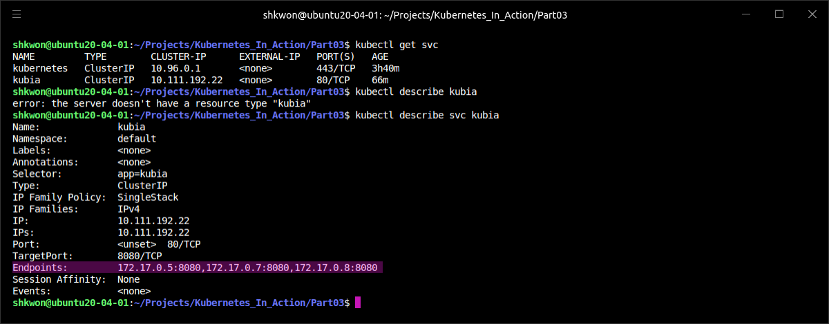
Connecting to Services(1/7)
Service Endpoints :
  Up to now, we’ve talked about services backed by one or more pods running inside the cluster. But cases exist when you’d like to expose external services through the Kubernetes services feature. Instead of having the service redirect connections to pods in the cluster, you want it to redirect to external IP(s) and port(s).
  This allows you to take advantage of both service load balancing and service discovery. Client pods running in the cluster can connect to the external service like they connect to internal services.
  Services don’t link to pods directly. Instead, a resource sits in between—the Endpoints resource. You may have already noticed endpoints if you used the “kubectl describe” command on your service, as show in the following screenshot.

Slide 30
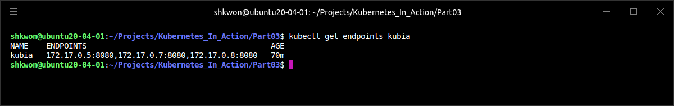
Connecting to Services(2/7)
Service Endpoints :
  An Endpoints resource (yes, plural) is a list of IP addresses and ports exposing a service. The Endpoints resource is like any other Kubernetes resource, so you can display its basic info with “kubectl get” :
  Although the pod selector is defined in the service spec, it’s not used directly when redirecting incoming connections. Instead, the selector is used to build a list of IPs and ports, which is then stored in the Endpoints resource. When a client connects to a service, the “service proxy” selects one of those IP and port pairs and redirects the incoming connection to the server listening at that location.
$ kubectl get endpoints kubia

Slide 31
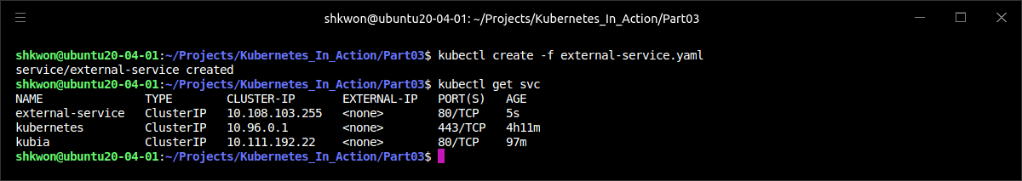
Connecting to Services(3/7)
Manually Configuring Service Endpoints :
  Having the service’s endpoints decoupled from the service allows them to be configured and updated manually.
  If you create a service without a pod selector, Kubernetes won’t even create the Endpoints resource (after all, without a selector, it can’t know which pods to include in the service). It’s up to you to create the Endpoints resource to specify the list of endpoints for the service.
  To create a service with manually managed endpoints, you need to create both a Service and an Endpoints resource.
  You’ll first create the YAML for the service itself, as shown in the following listing.
  NOTE : You’re defining a service called “external-service” that will accept incoming connections on port 80. You didn’t define a pod selector for the service.
apiVersion: v1
kind: Service
metadata:
name: external-service
spec:
ports:
- port: 80
external-service.yaml

Slide 32
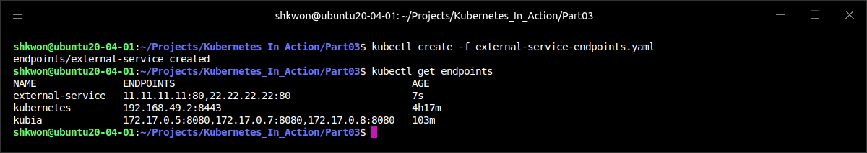
Connecting to Services(4/7)
Creating an Endpoints Resource for a Service without a Selector :
  Endpoints are a separate resource and not an attribute of a service. Because you created the service without a selector, the corresponding Endpoints resource hasn’t been created automatically, so it’s up to you to create it. The following listing shows its YAML manifest.
apiVersion: v1
kind: Endpoints
metadata:
name: external-service
subsets:
- addresses:
- ip: 11.11.11.11
- ip: 22.22.22.22
ports:
- port: 80
external-service-endpoints.yaml

Slide 33
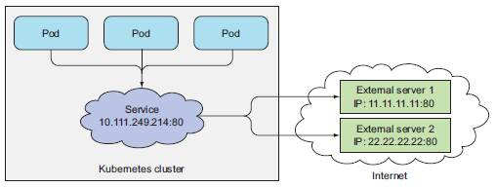
Connecting to Services(5/7)
Creating an Endpoints Resource for a Service without a Selector :
  The Endpoints object needs to have the same name as the service and contain the list of target IP addresses and ports for the service. After both the Service and the Endpoints resource are posted to the server, the service is ready to be used like any regular service with a pod selector. Containers created after the service is created will include the environment variables for the service, and all connections to its “IP:port” pair will be load balanced between the service’s endpoints.
  The following figure shows three pods connecting to the service with external endpoints.
  If you later decide to migrate the external service to pods running inside Kubernetes, you can add a selector to the service, thereby making its Endpoints managed automatically. The same is also true in reverse—by removing the selector from a Service, Kubernetes stops updating its Endpoints. This means a service IP address can remain constant while the actual implementation of the service is changed.

Slide 34
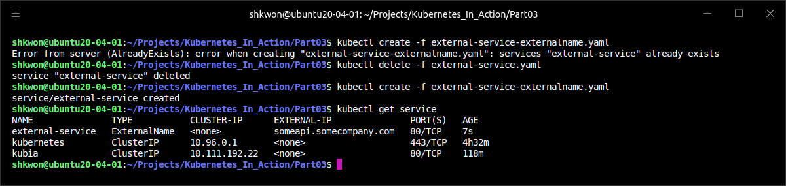
Connecting to Services(6/7)
Creating an Alias for an External Service :
  Instead of exposing an external service by manually configuring the service’s Endpoints, a simpler method allows you to refer to an external service by its fully qualified domain name (FQDN).
  To create a service that serves as an alias for an external service, you create a Service resource with the “type” field set to “ExternalName”. For example, let’s imagine there’s a public API available at “api.somecompany.com”. You can define a service that points to it as shown in the following listing.
apiVersion: v1
kind: Service
metadata:
name: external-service
spec:
type: ExternalName
externalName: someapi.somecompany.com
ports:
- port: 80
external-service-externalname.yaml

Slide 35
Connecting to Services(7/7)
Creating an Alias for an External Service :
  After the service is created, pods can connect to the external service through the “external-service.default.svc.cluster.local” domain name (or even “external-service”) instead of using the service’s actual FQDN.
  This hides the actual service name and its location from pods consuming the service, allowing you to modify the service definition and point it to a different service any time later, by only changing the externalName attribute or by changing the type back to ClusterIP and creating an Endpoints object for the service—either manually or by specifying a label selector on the service and having it created automatically.
  “ExternalName” services are implemented solely at the DNS level—a simple “CNAME DNS” record is created for the service. Therefore, clients connecting to the service will connect to the external service directly, bypassing the service proxy completely. For this reason, these types of services don’t even get a cluster IP.
  NOTE : A “CNAME” record points to a fully qualified domain name instead of a numeric IP address.

Slide 36
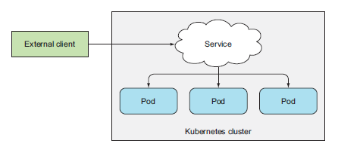
Exposing Services to External Clients(1/12)
Accessing Services from External Clients :
  Up to now, we’ve only talked about how services can be consumed by pods from inside the cluster. But you’ll also want to expose certain services, such as frontend webservers, to the outside, so external clients can access them, as depicted in the following figure.
  You have a few ways to make a service accessible externally :
    Setting the service type to NodePort—For a NodePort service, each cluster node opens a port on the node itself (hence the name) and redirects traffic received on that port to the underlying service. The service isn’t accessible only at the internal cluster IP and port, but also through a dedicated port on all nodes.
    Setting the service type to LoadBalancer, an extension of the NodePort type—This makes the service accessible through a dedicated load balancer, provisioned from the cloud infrastructure Kubernetes is running on. The load balancer redirects traffic to the node port across all the nodes. Clients connect to the service through the load balancer’s IP.
    Creating an Ingress resource, a radically different mechanism for exposing multiple services through a single IP address—It operates at the HTTP level (network layer 7) and can thus offer more features than layer 4 services can.

Slide 37
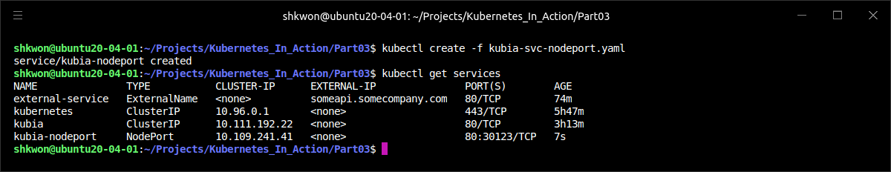
Exposing Services to External Clients(2/12)
Using NodePort Service :
  The first method of exposing a set of pods to external clients is by creating a service and setting its type to NodePort. By creating a “NodePort“ service, you make Kubernetes reserve a port on all its nodes (the same port number is used across all of them) and forward incoming connections to the pods that are part of the service.
  This is similar to a regular service (their actual type is ClusterIP), but a NodePort service can be accessed not only through the service’s internal cluster IP, but also through any node’s IP and the reserved node port.
  You’ll now create a NodePort service to see how you can use it. The following listing shows the YAML for the service.
apiVersion: v1
kind: Service
metadata:
name: kubia-nodeport
spec:
type: NodePort
ports:
- port: 80
targetPort: 8080
nodePort: 30123
selector:
app: kubia
kubia-svc-nodeport.yaml

Slide 38
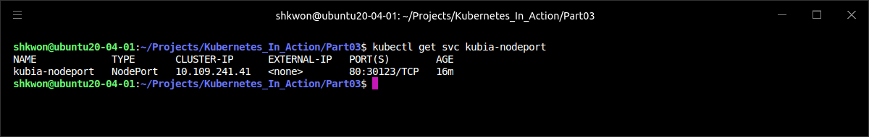
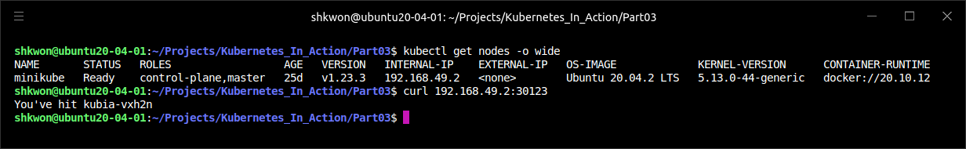
Exposing Services to External Clients(3/12)
Examining Your NodePort Service :
  In the previous YAML file, you set the type to NodePort and specify the node port this service should be bound to across all cluster nodes. Specifying the port isn’t mandatory; Kubernetes will choose a random port if you omit it. Let’s see the basic information of your service to learn more about it :
  Look at the “EXTERNAL-IP” column. It shows “<none>”, indicating the service is not accessible through the IP address of any cluster node. The “PORT(S)” column shows both the internal port of the cluster IP (“80”) and the node port (“30123”). The service is accessible at the following way :
$ kubectl get svc kubia-nodeport

Slide 39
Exposing Services to External Clients(4/12)
Examining Your NodePort Service :
  The following figure shows your service exposed on port “30123” of both of your cluster nodes (this applies if you’re running this on GKE; Minikube only has a single node, but the principle is the same). An incoming connection to one of those ports will be redirected to a randomly selected pod, which may or may not be the one running on the node the connection is being made to.
NodePort
NodePort
A connection received on port “30123” of the first node might be forwarded either to the pod running on the first node or to one of the pods running on the second node.

Slide 40
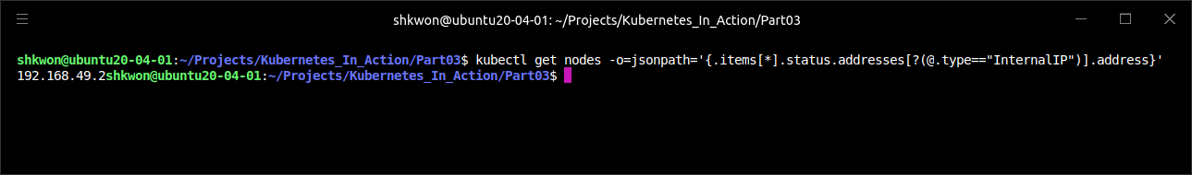
NOTE : JSONPath
Using JSONPath to Get the IPs of All Your Nodes :
  You can find the IP in the JSON or YAML descriptors of the nodes. But instead of sifting through the relatively large JSON, you can tell kubectl to print out only the node IP instead of the whole service definition :
  You’re telling kubectl to only output the information you want by specifying a “JSONPath”. You’re probably familiar with “XPath” and how it’s used with “XML”. “JSONPath” is basically “XPath” for “JSON”. The “JSONPath” in the previous example instructs kubectl to do the following :
    Go through all the elements in the items attribute.
    For each element, enter the status attribute.
    Filter elements of the addresses attribute, taking only those that have the type attribute set to ExternalIP.
    Finally, print the address attribute of the filtered elements.
  To learn more about how to use JSONPath with kubectl, refer to the documentation at http://kubernetes.io/docs/user-guide/jsonpath.
$ kubectl get nodes –o=jsonpath='{.items[*].status.addresses[?(@.type==“InternalIP")].address}'

Slide 41

Exposing Services to External Clients(5/12)
Examining Your NodePort Service :
  Once you know the IPs of your nodes, you can try accessing your service through them :
  TIP : When using Minikube, you can easily access your NodePort services through your browser by running “minikube service <service-name> [-n <namespace>]”.
  As you can see, your pods are now accessible to the whole internet through port 30123 on any of your nodes. It doesn’t matter what node a client sends the request to. But if you only point your clients to the first node, when that node fails, your clients can’t access the service anymore. That’s why it makes sense to put a load balancer in front of the nodes to make sure you’re spreading requests across all healthy nodes and never sending them to a node that’s offline at that moment.
  If your Kubernetes cluster supports it (which is mostly true when Kubernetes is deployed on cloud infrastructure), the load balancer can be provisioned automatically by creating a “LoadBalancer” instead of a NodePort service.
$ curl http://<node_IP_address>:30123

Slide 42
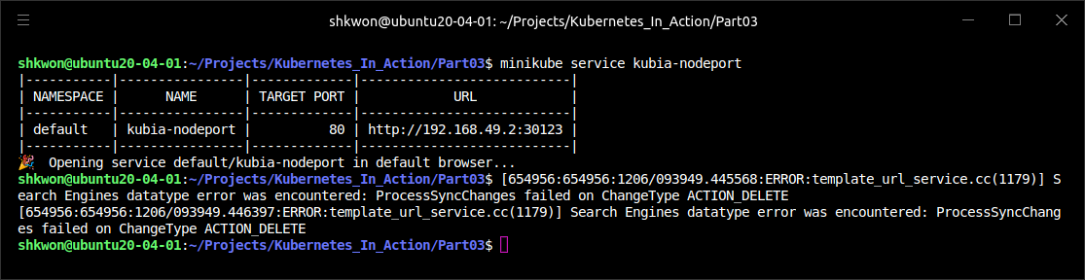
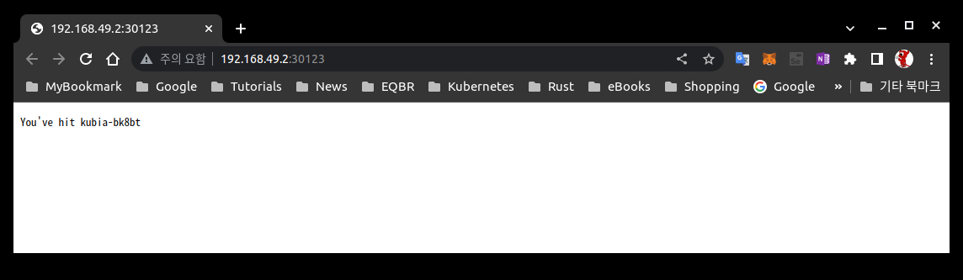
NOTE : Using NodePort in Minikube
Accessing Service Using Minikube :
  You can use the “minikube service kubia-nodeport” command to access the previous service.

Slide 43
Exposing Services to External Clients(6/12)
Exposing a Service Through an External Load Balancer :
  Kubernetes clusters running on cloud providers usually support the automatic provision of a load balancer from the cloud infrastructure. All you need to do is set the service’s type to LoadBalancer instead of NodePort. The load balancer will have its own unique, publicly accessible IP address and will redirect all connections to your service. You can thus access your service through the load balancer’s IP address.
  If Kubernetes is running in an environment that doesn’t support LoadBalancer services, the load balancer will not be provisioned, but the service will still behave like a NodePort service. That’s because a LoadBalancer service is an extension of a NodePort service. Google Kubernetes Engine(GKE) supports LoadBalancer services. But, Minikube doesn’t.
  To create a service with a load balancer in front, create the service from the following YAML manifest, as shown in the following listing.
  NOTE : The service type is set to LoadBalancer instead of NodePort. You’re not specifying a specific node port, although you could (you’re letting Kubernetes choose one instead).
apiVersion: v1
kind: Service
metadata:
name: kubia-loadbalancer
spec:
type: LoadBalancer
ports:
- port: 80
targetPort: 8080
selector:
app: kubia
kubia-svc-loadbalancer.yaml

Slide 44
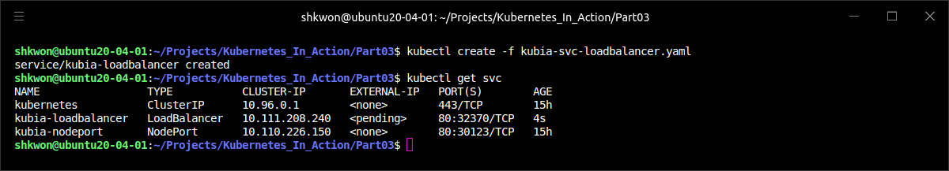
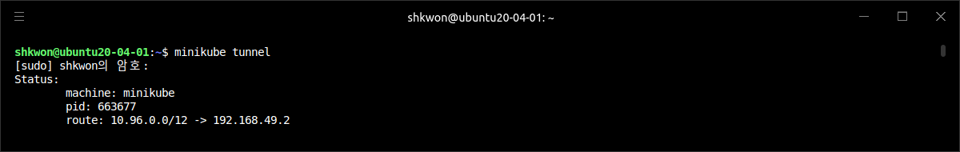
Exposing Services to External Clients(7/12)
Connecting to the Service Through the Load Balancer :
  After you create the service, it takes time for the cloud infrastructure to create the load balancer and write its IP address into the Service object. Once it does that, the IP address will be listed as the external IP address of your service :
  NOTICE : In Minkube, there is no load balancer for default. So it will only shows “<pending>” in “EXTERNAL-IP” column. To use LoadBalancer type service in Minikube, you need to run “minikube tunnel” in another terminal.

Slide 45
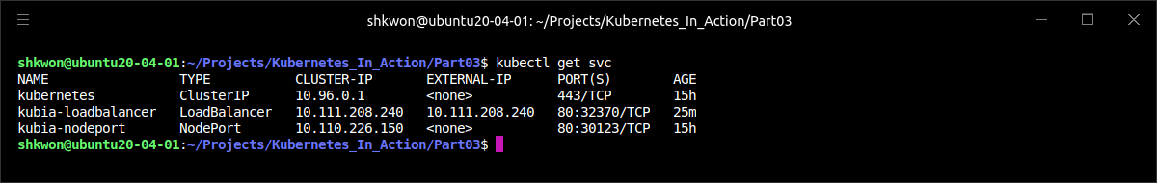
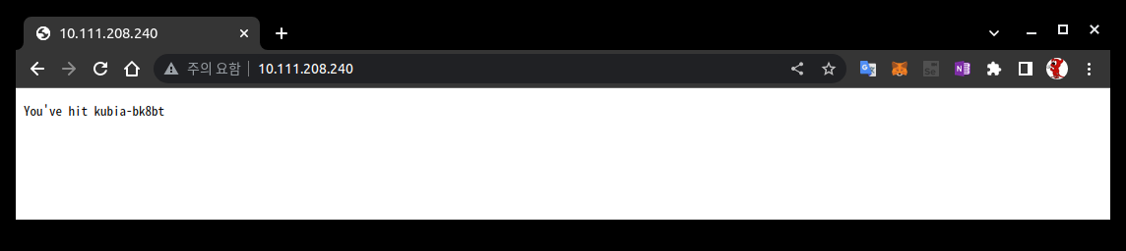
NOTE : Minikube
Using minikube tunnel Command :
  After you run the “minikube tunnel” command in another terminal, you can see the following screenshot.
  Now you can access the service the with browser like the following screenshot.
  Whenever you refresh the browser, you will see different response from the service.
  NOTE : When you run the “minikube tunnel” command, you need to provide your password.

Slide 46
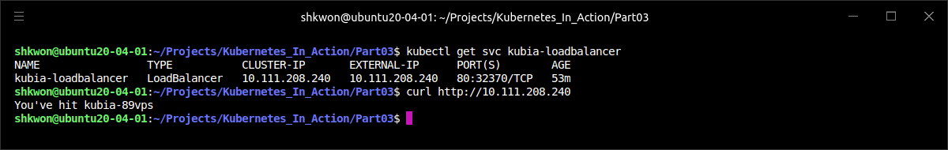
Exposing Services to External Clients(8/12)
Connecting to the Service Through the Load Balancer :
  The load balancer is available at IP 10.111.208.240, so you can now access the service at that IP address. Use “$ curl http://10.111.208.240” to access the service.
  NOTE : This time you didn’t need to mess with firewalls the way you had to before with the NodePort service.

Slide 47
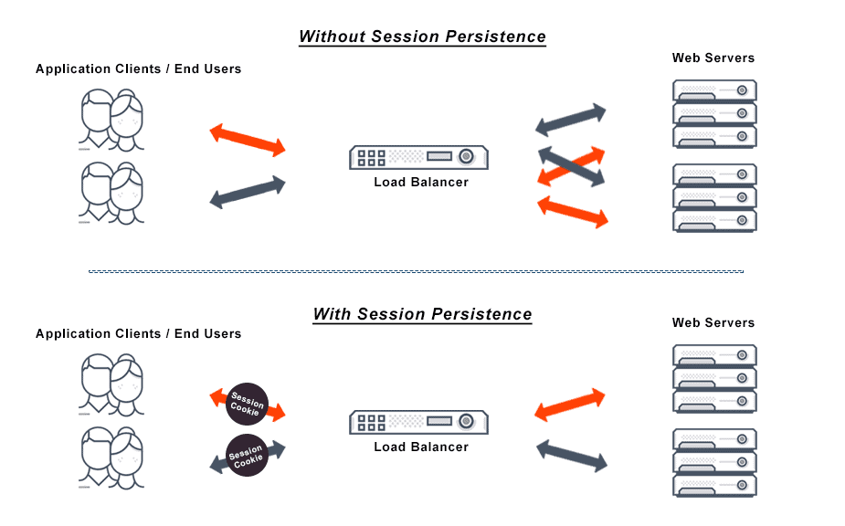
NOTE : Session Affinity And Web Browsers
Browser Session :
  Because your service is now exposed externally, you may try accessing it with your web browser. You’ll see something that may strike you as odd—the browser will hit the exact same pod every time. Did the service’s session affinity change in the meantime? With kubectl explain, you can double-check that the service’s session affinity is still set to “None”, so why don’t different browser requests hit different pods, as is the case when using curl?
  The browser is using keep-alive connections and sends all its requests through a single connection, whereas curl opens a new connection every time. Services work at the connection level, so when a connection to a service is first opened, a random pod is selected and then all network packets belonging to that connection are all sent to that single pod.
  Even if session affinity is set to None, users will always hit the same pod (until the connection is closed).

Slide 48
Exposing Services to External Clients(9/12)
Connecting to the Service Through the Load Balancer :
  The following figure shows how HTTP requests are delivered to the pod. External clients (curl in your case) connect to port 80 of the load balancer and get routed to the implicitly assigned node port on one of the nodes. From there, the connection is forwarded to one of the pod instances.
  As already mentioned, a LoadBalancer-type service is a NodePort service with an additional infrastructure-provided load balancer. If you use kubectl describe to display additional info about the service, you’ll see that a node port has been selected for the service. If you were to open the firewall for this port, the way you did in the previous section about NodePort services, you could access the service through the node IPs as well.
  TIP : If you’re using Minikube, even though the load balancer will never be provisioned, you can still access the service through the node port (at the Minikube VM’s IP address).

Slide 49
Exposing Services to External Clients(10/12)
Understanding and Preventing Unnecessary Network Hops :
  When an external client connects to a service through the node port (this also includes cases when it goes through the load balancer first), the randomly chosen pod may or may not be running on the same node that received the connection. An additional network hop is required to reach the pod, but this may not always be desirable.
  You can prevent this additional hop by configuring the service to redirect external traffic only to pods running on the node that received the connection. This is done by setting the “externalTrafficPolicy” field in the service’s spec section :
  If a service definition includes this setting and an external connection is opened through the service’s node port, the service proxy will choose a locally running pod. If no local pods exist, the connection will hang (it won’t be forwarded to a random global pod, the way connections are when not using the annotation). You therefore need to ensure the load balancer forwards connections only to nodes that have at least one such pod.
  Using this annotation also has other drawbacks. Normally, connections are spread evenly across all the pods, but when using this annotation, that’s no longer the case.
spec:
externalTrafficPolicy: Local
...

Slide 50
Exposing Services to External Clients(11/12)
Understanding and Preventing Unnecessary Network Hops :
  For example, imagine having two nodes and three pods. Let’s say node A runs one pod and node B runs the other two. If the load balancer spreads connections evenly across the two nodes, the pod on node A will receive 50% of all connections, but the two pods on node B will only receive 25% each(not evenly spread), as shown in the following figure.

Slide 51
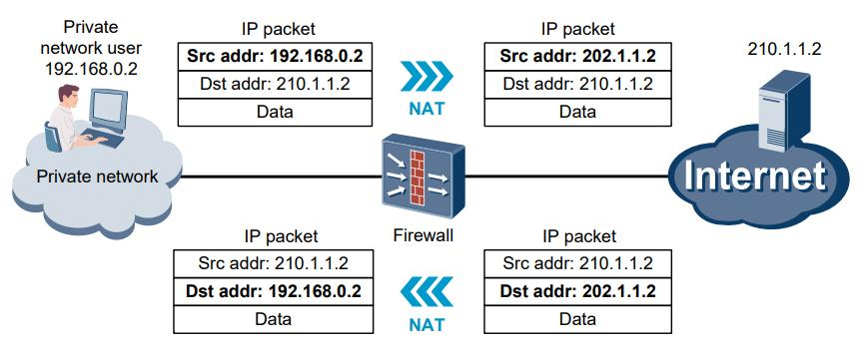
Exposing Services to External Clients(12/12)
Being Aware of the Non-Preservation of the Client’s IP :
  Usually, when clients inside the cluster connect to a service, the pods backing the service can obtain the client’s IP address. But when the connection is received through a node port, the packets’ source IP is changed, because Source Network Address Translation (SNAT) is performed on the packets.
  The backing pod can’t see the actual client’s IP, which may be a problem for some applications that need to know the client’s IP. In the case of a web server, for example, this means the access log won’t show the browser’s IP.
  The Local external traffic policy described in the previous pages affects the preservation of the client’s IP, because there’s no additional hop between the node receiving the connection and the node hosting the target pod (SNAT isn’t performed).

Slide 52
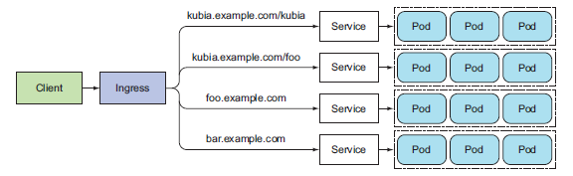
Exposing Services Externally Through an Ingress Resource(1/16)
Ingress Resource :
  You’ve now seen two ways of exposing a service to clients outside the cluster, but another method exists—creating an Ingress resource.
    “DEFINITION Ingress (noun)—The act of going in or entering; the right to enter; a means or place of entering; entryway”.
  One important reason is that each LoadBalancer service requires its own load balancer with its own public IP address, whereas an Ingress only requires one, even when providing access to dozens of services. When a client sends an HTTP request to the Ingress, the host and path in the request determine which service the request is forwarded to, as shown in the following figure.
  Ingresses operate at the application layer of the network stack (HTTP) and can provide features such as cookie-based session affinity and the like, which services can’t.

Slide 53
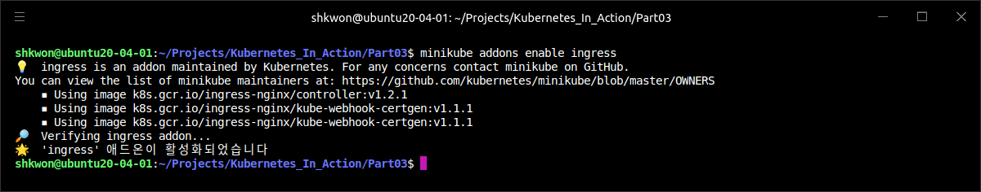
Exposing Services Externally Through an Ingress Resource(2/16)
Understanding an Ingress Controller :
  To make Ingress resources work, an Ingress controller needs to be running in the cluster. Different Kubernetes environments use different implementations of the controller, but several don’t provide a default controller at all.
  For example, Google Kubernetes Engine uses Google Cloud Platform’s own HTTP load-balancing features to provide the Ingress functionality. Initially, Minikube didn’t provide a controller out of the box, but it now includes an add-on that can be enabled to let you try out the Ingress functionality.
  To enable the “Ingress addons” in minikube, you need to run the following command.
$ minikube addons enable ingress

Slide 54
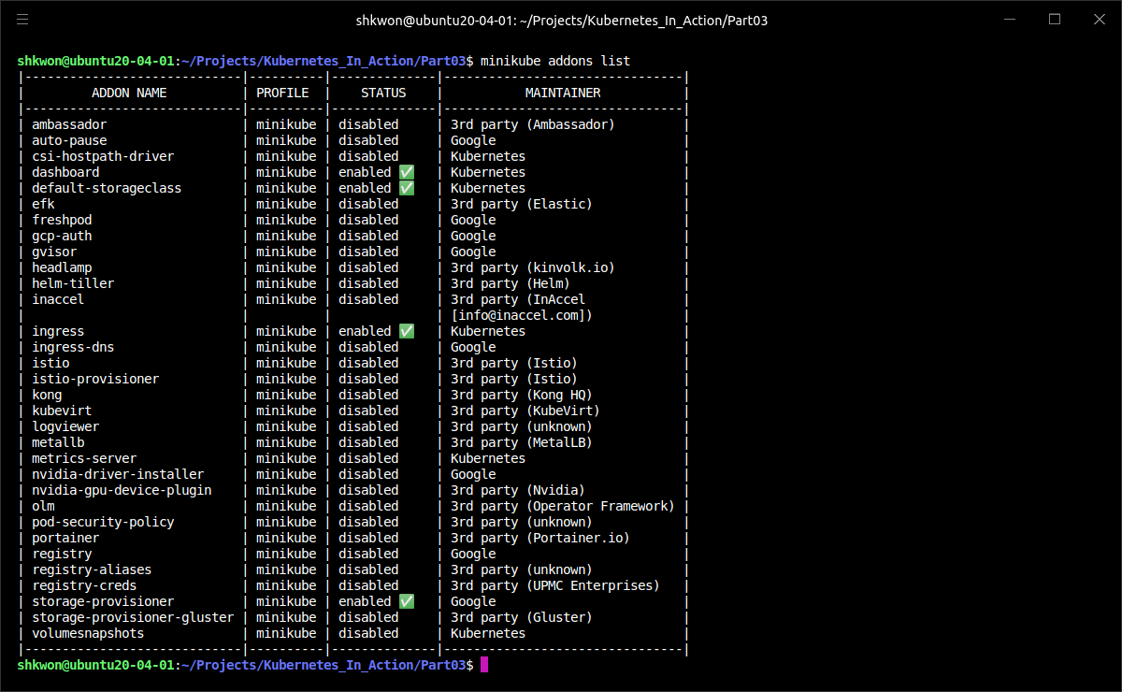
NOTE : Minikube Addons
Checking Minikube Addons :
  You can use “minikube addons list” command to see the status of all addons.

Slide 55
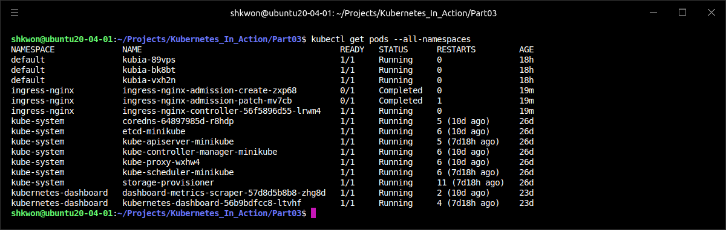
Exposing Services Externally Through an Ingress Resource(3/16)
Understanding an Ingress Controller :
  The “minikube addons enable ingress” command should have spun up an Ingress controller as another pod. Most likely, the controller pod will be in the “kube-system” namespace, but not necessarily, so list all the running pods across all namespaces by using the “--all-namespaces” option :
  NOTE : The name suggests that Nginx (an open-source HTTP server and reverse proxy) is used to provide the Ingress functionality.
$ kubectl get po --all-namespaces

Slide 56
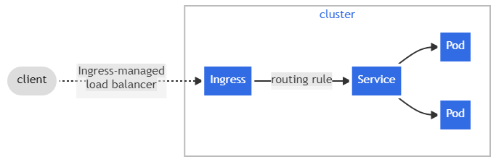
Exposing Services Externally Through an Ingress Resource(4/16)
Creating an Ingress Resource :
  You’ve confirmed there’s an Ingress controller running in your cluster, so you can now create an Ingress resource. The following listing shows what the YAML manifest for the Ingress looks like.
apiVersion: networking.k8s.io/v1
kind: Ingress
metadata:
name: kubia
spec:
rules:
- host: kubia.example.com
http:
paths:
- path: /
pathType: Prefix
backend:
service:
name: kubia-nodeport
port:
number: 80
kubia-ingress.yaml

Slide 57

Exposing Services Externally Through an Ingress Resource(5/16)
Creating an Ingress Resource :
  The “kubia-ingress.yaml” defines an Ingress with a single rule, which makes sure all HTTP requests received by the Ingress controller, in which the host “kubia.example.com” is requested, will be sent to the “kubia-nodeport” service on port “80”.
  NOTE : Ingress controllers on cloud providers (in GKE, for example) require the Ingress to point to a “NodePort” service. But that’s not a requirement of Kubernetes itself.

Slide 58

NOTE : Registering Host Name
Adding the Exposed Host Name :
  Now, you can add the exposed host name into “/etc/hosts” file. To edit this file, you need to run “$ sudo vi /etc/hosts” command. Then enter your password.

Slide 59

Exposing Services Externally Through an Ingress Resource(6/16)
Accessing the Service Through the Ingress :
  To access your service through “http://kubia.example.com,” you’ll need to make sure the domain name resolves to the IP of the Ingress controller.
  To look up the IP, you need to list Ingresses :
  NOTE : When running on cloud providers, the address may take time to appear, because the Ingress controller provisions a load balancer behind the scenes. The IP is shown in the “ADDRESS” column.
$ kubectl get ingresses

Slide 60


Exposing Services Externally Through an Ingress Resource(7/16)
Accessing the Service Through the Ingress :
  Once you know the IP, you can then either configure your DNS servers to resolve “kubia.example.com” to that IP or you can add the following line to “/etc/hosts” on Linux (or C:\windows\system32\drivers\etc\hosts on Windows) :
  Now you can access the service at ”http://kubia.example.com” (using a browser or curl):
…
192.168.49.2 kubia.example.com
…
/etc/hosts
$ curl http://kubia.example.com

Slide 61

Exposing Services Externally Through an Ingress Resource(8/16)
Understanding How Ingresses Work :
  The following shows how the client connected to one of the pods through the Ingress controller. The client first performed a DNS lookup of “kubia.example.com”, and the DNS server (or the local operating system) returned the IP of the Ingress controller. The client then sent an HTTP request to the Ingress controller and specified “kubia.example.com” in the Host header. From that header, the controller determined which service the client is trying to access, looked up the pod IPs through the Endpoints object associated with the service, and forwarded the client’s request to one of the pods.
  As you can see, the Ingress controller didn’t forward the request to the service. It only used it to select a pod. Most, if not all, controllers work like this.

Slide 62
Exposing Services Externally Through an Ingress Resource(9/16)
Exposing Multiple Services Through the Same Ingress :
  If you look at the Ingress spec closely, you’ll see that both rules and paths are arrays, so they can contain multiple items. An Ingress can map multiple hosts and paths to multiple services.
  You can map multiple paths on the same host to different services, as shown in the following listing.
  In this case, requests will be sent to two different services, depending on the path in the requested URL. Clients can therefore reach two different services through a single IP address of the Ingress controller.
apiVersion: networking.k8s.io/v1
kind: Ingress
metadata:
name: kubia
spec:
rules:
- host: kubia.example.com
http:
paths:
- path: /kubia
pathType: Prefix
backend:
service:
name: kubia
port:
number: 80
- path: /foo
pathType: Prefix
backend:
service:
name: bar
port:
number: 80
kubia-ingress-multiple-path.yaml

Slide 63

Exposing Services Externally Through an Ingress Resource(10/16)
Exposing Multiple Services Through the Same Ingress :
  To access the service, you can use the “$ curl kubia.example.com/kubia” command. In this case, you cannot access “kubia.example.com”. It shows that “404 Not Found” error message from Nginx Ingress Controller.

Slide 64
Exposing Services Externally Through an Ingress Resource(11/16)
Mapping Different Services to Different Hosts :
  Similarly, you can use an Ingress to map to different services based on the host in the HTTP request instead of (only) the path, as shown in the next listing.
  Requests received by the controller will be forwarded to either service “foo” or “bar”, depending on the Host header in the request (the way virtual hosts are handled in web servers). DNS needs to point both the “foo.example.com” and the “bar.example.com” domain names to the Ingress controller’s IP address.
apiVersion: networking.k8s.io/v1
kind: Ingress
metadata:
name: kubia
spec:
rules:
- host: foo.example.com
http:
paths:
- path: /
pathType: Prefix
backend:
service:
name: foo
port:
number: 80
- host: bar.example.com
http:
paths:
- path: /
pathType: Prefix
backend:
service:
name: bar
port:
number: 80
kubia-ingress-multiple-host.yaml

Slide 65

NOTE : Adding Ingress
Multiple Host :
  To create the Ingress resource for the previous example, you can run “$ kubectl create -f kubia-ingress-multiple-host.yaml” command. Before you run the command, you can also delete the previous ingress resource with “$ kubectl delete -f kubia-ingress-multiple-path.yaml” command.

Slide 66

Exposing Services Externally Through an Ingress Resource(12/16)
Configuring Ingress to Handle TLS Traffic :
  You’ve seen how an Ingress forwards HTTP traffic. Let’s take a quick look at how to configure Ingress to support TLS(Transport Layer Security).
  When a client opens a TLS connection to an Ingress controller, the controller terminates the TLS connection. The communication between the client and the controller is encrypted, whereas the communication between the controller and the backend pod isn’t.
  The application running in the pod doesn’t need to support TLS. For example, if the pod runs a web server, it can accept only HTTP traffic and let the Ingress controller take care of everything related to TLS. To enable the controller to do that, you need to attach a certificate and a private key to the Ingress. The two need to be stored in a Kubernetes resource called a Secret, which is then referenced in the Ingress manifest.
  For now, you’ll create the Secret without paying too much attention to it. First, you need to create the private key and certificate :
$ openssl genrsa -out tls.key 2048
$ openssl req -new -x509 -key tls.key -out tls.cert -days 360 –subj /CN=kubia.example.com

Slide 67

Exposing Services Externally Through an Ingress Resource(13/16)
Configuring Ingress to Handle TLS Traffic :
  Then you create the Secret from the two files(“tls.cert” and “tls.key”) like this :
  The private key and the certificate are now stored in the Secret called “tls-secret”. Now, you can update your Ingress object so it will also accept HTTPS requests for “kubia.example.com”.
$ kubectl create secret tls tls-secret --cert=tls.cert --key=tls.key

Slide 68
Exposing Services Externally Through an Ingress Resource(14/16)
Configuring Ingress to Handle TLS Traffic :
  To use Secret, the Ingress manifest should now look like the following listing.
  TIP : Instead of deleting the Ingress and re-creating it from the new file, you can invoke “kubectl apply -f kubia-ingress-secret.yaml”, which updates the Ingress resource with what’s specified in the file.
apiVersion: networking.k8s.io/v1
kind: Ingress
metadata:
name: kubia
spec:
tls:
- hosts:
- kubia.example.com
secretName: tls-secret
rules:
- host: kubia.example.com
http:
paths:
- path: /
pathType: Prefix
backend:
service:
name: kubia-nodeport
port:
number: 80
kubia-ingress-secret.yaml

Slide 69

Exposing Services Externally Through an Ingress Resource(15/16)
Configuring Ingress to Handle TLS Traffic :
  Now, you can create the Ingress resource with “$ kubectl create -f kubia-ingress-sercret.yaml” command. Before you run the command, you can check the secret with “$ kubectl get secret” command.

Slide 70


Exposing Services Externally Through an Ingress Resource(16/16)
Configuring Ingress to Handle TLS Traffic :
  You can now use HTTPS to access your service through the Ingress :
  NOTE : The command’s output shows the response from the app, as well as the server certificate you configured the Ingress with.
  NOTE : Support for Ingress features varies between the different Ingress controller implementations, so check the implementation-specific documentation to see what’s supported. Ingresses are a relatively new Kubernetes feature, so you can expect to see many improvements and new features in the future. Although they currently support only L7 (HTTP/HTTPS) load balancing, support for L4 load balancing is also planned.
$ curl -k -v https://kubia.example.com

Slide 71

Signaling When a Pod is Ready to Accept Connections(1/12)
Readiness Probe :
  As soon as a new pod with proper labels is created, it becomes part of the service and requests start to be redirected to the pod. But what if the pod isn’t ready to start serving requests immediately?
  The pod may need time to load either configuration or data, or it may need to perform a warm-up procedure to prevent the first user request from taking too long and affecting the user experience. In such cases you don’t want the pod to start receiving requests immediately, especially when the already-running instances can process requests properly and quickly. It makes sense to not forward requests to a pod that’s in the process of starting up until it’s fully ready.
  You already learned about liveness probes and how they help keep your apps healthy by ensuring unhealthy containers are restarted automatically. Similar to liveness probes, Kubernetes allows you to also define a readiness probe for your pod.
  The readiness probe is invoked periodically and determines whether the specific pod should receive client requests or not. When a container’s readiness probe returns success, it’s signaling that the container is ready to accept requests.
  This notion of being ready is obviously something that’s specific to each container. Kubernetes can merely check if the app running in the container responds to a simple “GET / request” or it can hit a specific URL path, which causes the app to perform a whole list of checks to determine if it’s ready. Such a detailed readiness probe, which takes the app’s specifics into account, is the app developer’s responsibility.

Slide 72

Signaling When a Pod is Ready to Accept Connections(2/12)
Types of Readiness Probes :
  Like liveness probes, three types of readiness probes exist :
    An Exec probe, where a process is executed. The container’s status is determined by the process’ exit status code.
    An HTTP GET probe, which sends an HTTP GET request to the container and the HTTP status code of the response determines whether the container is ready or not.
    A TCP Socket probe, which opens a TCP connection to a specified port of the container. If the connection is established, the container is considered ready.

Slide 73
Signaling When a Pod is Ready to Accept Connections(3/12)
Understanding the Operation of Readiness Probes :
  When a container is started, Kubernetes can be configured to wait for a configurable amount of time to pass before performing the first readiness check. After that, it invokes the probe periodically and acts based on the result of the readiness probe. If a pod reports that it’s not ready, it’s removed from the service. If the pod then becomes ready again, it’s re-added.
  Unlike liveness probes, if a container fails the readiness check, it won’t be killed or restarted. This is an important distinction between liveness and readiness probes. Liveness probes keep pods healthy by killing off unhealthy containers and replacing them with new, healthy ones, whereas readiness probes make sure that only pods that are ready to serve requests receive them. This is mostly necessary during container start up, but it’s also useful after the container has been running for a while.
  As you can see in the following figure, if a pod’s readiness probe fails, the pod is removed from the Endpoints object. Clients connecting to the service will not be redirected to the pod. The effect is the same as when the pod doesn’t match the service’s label selector at all.

Slide 74

Signaling When a Pod is Ready to Accept Connections(4/12)
Understanding Why Readiness Probes are Important :
  For example, imagine that a group of pods (for example, pods running application servers) depends on a service provided by another pod (a backend database, for example). If at any point one of the frontend pods experiences connectivity problems and can’t reach the database anymore, it may be wise for its readiness probe to signal to Kubernetes that the pod isn’t ready to serve any requests at that time. If other pod instances aren’t experiencing the same type of connectivity issues, they can serve requests normally.
  A readiness probe makes sure clients only talk to those healthy pods and never notice there’s anything wrong with the system.

Slide 75
Signaling When a Pod is Ready to Accept Connections(5/12)
Adding a Readiness Probe to a Pod :
  Now, you’ll add a readiness probe to your existing pods by modifying the ReplicationController’s pod template.
  You’ll use the following command to add the probe to the pod template in your existing ReplicationController :
  Find the container specification in the pod template and add the following readiness probe definition to the first container under “spec.template.spec.containers”. The YAML should look like the following listing.
  NOTE : Before you the above steps, you can delete all resources using “$kubectl delete all --all” command.
$ kubectl create -f kubia-rc.yaml
$ kubectl get rc kubia -o yaml > kubia-rc-readiness-probe.yaml
…
spec:
replicas: 3
selector:
app: kubia
template:
metadata:
creationTimestamp: null
labels:
app: kubia
spec:
containers:
- image: knix008/kubia
readinessProbe:
exec:
command:
- ls
- /var/ready
imagePullPolicy: Always
…
kubia-rc-readiness-probe.yaml

Slide 76

NOTE : Using Editor for Configuration Change
Environment Variables :
  To use “$ kubctl edit” command in the example, you need to add the following line at the end of “~/.bashrc” file on Ubuntu 20.04 Linux.
  The “KUBE_EDITOR” environment variable(“export KUBE_EDITOR=/usr/bin/vim”) also can be set in the same file.
  If you haven’t installed “vim” editor, you need to run the “$ sudo apt install vim” command.
  When you finish editing the manifest file, “ESC” and “:” keys, then type “wq” to change and save the edited file.
  NOTICE : Sometimes, the “$kubectl edit” command will not work correctly. So save the manifest file and edit it directly.
export EDITOR=/usr/bin/vim

Slide 77

Signaling When a Pod is Ready to Accept Connections(6/12)
Adding a Readiness Probe to a Pod :
  The readiness probe will periodically perform the command “ls /var/ready” inside the container. The “ls” command returns exit code zero if the file exists, or a non-zero exit code otherwise. If the file exists, the readiness probe will succeed; otherwise, it will fail.
  The reason you’re defining such a strange readiness probe is so you can toggle its result by creating or removing the file in question. The file doesn’t exist yet, so all the pods should now report not being ready, right? Well, not exactly. As you know, changing a ReplicationController’s pod template has no effect on existing pods.
  In other words, all your existing pods still have no readiness probe defined. You can see this by listing the pods with “kubectl get pods” and looking at the READY column. You need to delete the pods and have them re-created by the ReplicationController. The new pods will fail the readiness check and won’t be included as endpoints of the service until you create the “/var/ready” file in each of them.
  Now, you can create the new ReplicationController with the following command :
$ kubectl delete -f kubia-rc.yaml
…
$ kubectl create -f kubia-rc-readiness-probe.yaml

Slide 78


Signaling When a Pod is Ready to Accept Connections(7/12)
Observing and Modifying the Pods’ Readiness Status :
  List the pods again and inspect whether they’re ready or not :
  The “READY” column shows that none of the containers are ready. Now make the readiness probe of one of them start returning success by creating the “/var/ready” file, whose existence makes your mock readiness probe succeed :
$ kubectl get pods
$ kubectl exec kubia-2h49c -- touch /var/ready

Slide 79

Signaling When a Pod is Ready to Accept Connections(8/12)
Observing and Modifying the Pods’ Readiness Status :
  You’ve used the “kubectl exec” command to execute the “touch” command inside the container of the “kubia-2h49c” pod. The “touch” command creates the file if it doesn’t yet exist. The pod’s readiness probe command should now exit with status code 0, which means the probe is successful, and the pod should now be shown as ready. Let’s see if it is :

Slide 80


Signaling When a Pod is Ready to Accept Connections(9/12)
Observing and Modifying the Pods’ Readiness Status :
  Take a more detailed look at the pod with “$ kubectl describe pod kubia-2h49c” command. The output should contain the following line :
  The readiness probe is checked periodically—”every 10 seconds” by default. The pod isn’t ready because the readiness probe hasn’t been invoked yet. But in 10 seconds at the latest, the pod should become ready and its IP should be listed as the only endpoint of the service.

Slide 81


Signaling When a Pod is Ready to Accept Connections(10/12)
Observing and Modifying the Pods’ Readiness Status :
  Run “kubectl get endpoints” command to confirm that the pod is ready to service. Before you run the command, you need to create a Service for the kubia pods first.
  To toggle the readiness probe, you can run “$ kubectl exec kubia-2h49c -- rm /var/ready” command.

Slide 82


Signaling When a Pod is Ready to Accept Connections(11/12)
Observing and Modifying the Pods’ Readiness Status :
  After the deleting “/var/ready” file, 10 seconds(default) later, you can find the pod status with “$ kubectl get pods” command and list the endpoints with “$ kubectl get endpoints” command.
  NOTE : You can enable again the readiness probe in the same pods as above screenshot.

Slide 83

Signaling When a Pod is Ready to Accept Connections(12/12)
Understanding What Real-World Readiness Probes Should Do :
  In the real world, the readiness probe should return success or failure depending on whether the app can (and wants to) receive client requests or not.
  Manually removing pods from services should be performed by either deleting the pod or changing the pod’s labels instead of manually flipping a switch in the probe. Remove the label when you want to remove the pod from the service.
  TIP : If you want to add or remove a pod from a service manually, add “enabled=true” as a label to your pod and to the label selector of your service.
  NOTE : If you don’t add a readiness probe to your pods, they’ll become service endpoints almost immediately. If your application takes too long to start listening for incoming connections, client requests hitting the service will be forwarded to the pod while it’s still starting up and not ready to accept incoming connections. Clients will therefore see “Connection refused” types of errors.
  TIP : You should always define a readiness probe, even if it’s as simple as sending an HTTP request to the base URL.
  The other thing applies to the other end of the pod’s life (pod shutdown) and is also related to clients experiencing connection errors.
  When a pod is being shut down, the app running in it usually stops accepting connections as soon as it receives the termination signal. Because of this, you might think you need to make your readiness probe start failing as soon as the shutdown procedure is initiated, ensuring the pod is removed from all services it’s part of. But that’s not necessary, because Kubernetes removes the pod from all services as soon as you delete the pod.

Slide 84

Using a Headless Service for Discovering Individual Pods(1/7)
DNS Lookups :
  Services can be used to provide a stable IP address allowing clients to connect to pods (or other endpoints) backing each service. Each connection to the service is forwarded to one randomly selected backing pod. But what if the client needs to connect to all of those pods? What if the backing pods themselves need to each connect to all the other backing pods? Connecting through the service clearly isn’t the way to do this.
  For a client to connect to all pods, it needs to figure out the IP of each individual pod. One option is to have the client call the Kubernetes API server and get the list of pods and their IP addresses through an API call, but because you should always strive to keep your apps “Kubernetes-agnostic”, using the API server isn’t ideal.
  Kubernetes allows clients to discover pod IPs through “DNS lookups”. Usually, when you perform a DNS lookup for a service, the DNS server returns a single IP—the service’s cluster IP. But if you tell Kubernetes you don’t need a cluster IP for your service (you do this by setting the “clusterIP” field to “None” in the service specification), the DNS server will return the pod IPs instead of the single service IP.
  Instead of returning a single DNS A record, the DNS server will return multiple A records for the service, each pointing to the IP of an individual pod backing the service at that moment. Clients can therefore do a simple DNS A record lookup and get the IPs of all the pods that are part of the service. The client can then use that information to connect to one, many, or all of them.

Slide 85

Using a Headless Service for Discovering Individual Pods(2/7)
Creating a Headless Service :
  Setting the “clusterIP” field in a service spec to “None” makes the service headless, as Kubernetes won’t assign it a cluster IP through which clients could connect to the pods backing it.
  You’ll create a headless service called “kubia-headless” now. The following listing shows its definition.

Slide 86


Using a Headless Service for Discovering Individual Pods(3/7)
Creating a Headless Service :
  After you create the service with “kubectl create” command, you can inspect it with “kubectl get” and “kubectl describe” commands. You’ll see it has no cluster IP and its endpoints include (part of) the pods matching its pod selector. Because your pods contain a “readiness probe”, so only pods that are ready will be listed as endpoints of the service. Before continuing, please make sure at least two pods report being ready, by creating the “/var/ready” file, as in the previous example :
$ kubectl exec <pod name> -- touch /var/ready

Slide 87

Using a Headless Service for Discovering Individual Pods(4/7)
Discovering Pods Through DNS :
  With your pods ready, you can now try performing a DNS lookup to see if you get the actual pod IPs or not. You’ll need to perform the lookup from inside one of the pods. Unfortunately, your kubia container image doesn’t include the “nslookup” (or the “dig”) binary, so you can’t use it to perform the DNS lookup.
  All you’re trying to do is perform a DNS lookup from inside a pod running in the cluster. Why not run a new pod based on an image that contains the binaries you need? To perform DNS-related actions, you can use the “tutum/dnsutils” container image, which is available on Docker Hub and contains both the nslookup and the dig binaries. To run the pod, you can go through the whole process of creating a YAML manifest for it and passing it to “kubectl create” command.
  Fortunately, you can create pods without writing a YAML manifest by using the “kubectl run” command. For this time you want to create only a pod—you don’t need to create a “ReplicationController” to manage the pod. You can do that like this :
$ kubectl run dnsutils --image=tutum/dnsutils --command -- sleep infinity

Slide 88

Using a Headless Service for Discovering Individual Pods(5/7)
Discovering Pods Through DNS :
  Let’s use the newly created pod to perform a DNS lookup :
  The DNS server returns two different IPs for the “kubia-headless.default.svc.cluster.local” FQDN(Fully Qualified Domain Name). Those are the IPs of the two pods that are reporting being ready. You can confirm this by listing pods with “kubectl get pods -o wide”, which shows the pods’ IPs.
$ kubectl exec dnsutils -- nslookup kubia-headless

Slide 89

Using a Headless Service for Discovering Individual Pods(6/7)
Discovering Pods Through DNS :
  This is different from what DNS returns for regular (non-headless) services, such as for your “kubia” service, where the returned IP is the service’s cluster IP :
  Although headless services may seem different from regular services, they aren’t that different from the clients’ perspective. Even with a headless service, clients can connect to its pods by connecting to the service’s DNS name, as they can with regular services. But with headless services, because DNS returns the pods’ IPs, clients connect directly to the pods, instead of through the service proxy.
  NOTE : A headless services still provides load balancing across pods, but through the DNS round-robin mechanism instead of through the service proxy.
$ kubectl exec dnsutils -- nslookup kubia

Slide 90

Using a Headless Service for Discovering Individual Pods(7/7)
Discovering All Pods :
  Sometimes you want to use the service discovery mechanism to find all pods matching the service’s label selector, even those that aren’t ready. In this case, you don’t have to resort to querying the Kubernetes API server. You can use the DNS lookup mechanism to find even those unready pods. To tell Kubernetes you want all pods added to a service, regardless of the pod’s readiness status, you must add the following “Service.spec.publishedNotReady” to the service :
…
spec:
clusterIP: None
publishNotReadyAddresses: true
…
kubia-svc-headless.yaml

Slide 91
Troubleshooting Services
Checking Services Available :
  Services are a crucial Kubernetes concept and the source of frustration for many developers. When you’re unable to access your pods through the service, you should start by going through the following list :
    Make sure you’re connecting to the service’s cluster IP from within the cluster, not from the outside.
    Don’t bother pinging the service IP to figure out if the service is accessible (remember, the service’s cluster IP is a virtual IP and pinging it will never work).
    If you’ve defined a readiness probe, make sure it’s succeeding; otherwise the pod won’t be part of the service.
    To confirm that a pod is part of the service, examine the corresponding Endpoints object with “kubectl get endpoints” command.
    If you’re trying to access the service through its FQDN or a part of it (for example, “myservice.mynamespace.svc.cluster.local” or “myservice.mynamespace”) and it doesn’t work, see if you can access it using its cluster IP instead of the FQDN.
    Check whether you’re connecting to the port exposed by the service and not the target port.
    Try connecting to the pod IP directly to confirm your pod is accepting connections on the correct port.
    If you can’t even access your app through the pod’s IP, make sure your app isn’t only binding to localhost

Slide 92

Reference
[1] Kubernetes in Action, Marko Luksa, Manning, 2018 1st Edition.
[2] https://github.com/luksa/kubernetes-in-action

Slide 93

? & !

